Slide 1

Detecting Criminal Wallets
STUDENTS
INSTRUCTOR
Nehoray Chalfon
Ofer Zevin
Ori Sinvani
Github repo
Harel Brener
Group 4

Slide 2
BITCOIN IN NUMBERS
$1.2T
25M
market capitalization
Active wallets on the blockchain
545K
$14.8B
transactions every single day
moved on-chain every 24 hours

Slide 3

THE PROBLEM
$154B
received by illicit crypto addresses in 2025 alone
Every Bitcoin transaction is public.
Yet criminal wallets hide among
hundreds of millions of look-alike addresses.
Real Hamas funding campaign via blockchain
Crime on the blockchain hides in plain sight.

Slide 4
GOAL & APPROACH
GOAL
Classify any Bitcoin wallet as criminal or benign from its on-chain behavior and graph neighborhood — served as a usable web tool.
0.42 BTC
2.10 BTC
?
0.07 BTC
1.30 BTC
DATA
5.80 BTC
0.95 BTC
REAL-CATS — 40,032 criminal + 90,176 benign labeled addresses
Elliptic++ — 822K addresses with transaction features
Wallets + transactions form a graph — each address is a node, payments are edges
benign
illicit
wallet under analysis

Slide 5

WHY OUR APPROACH IS DIFFERENT
EXISTING APPROACHES
OUR PROJECT
Manual blockchain forensics
Dataset variety
Chainalysis-style — accurate but slow, expensive, closed-source
REAL-CATS(2023), Elliptic(2016) combined
Feature-only ML
Graph structure + attention
XGBoost on hand-crafted features — blind to graph structure
GATv2 learns which neighbors are suspicious context
Prior academic work
End-to-end live system
Transaction-level labels on Elliptic(2016) — risk of being outdated
Any address → mempool.space → calibrated risk score in a web app

Slide 6
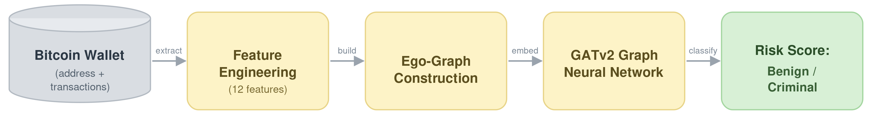
OUR SOLUTION — THE PIPELINE
Features
Ego-graphs
GATv2 GNN
Risk score
12 selected of 19 behavioral features per wallet
1-hop neighborhood graph built per wallet
Attention over neighbors → embedding → classifier
Temperature-calibrated probability served via API

Slide 7
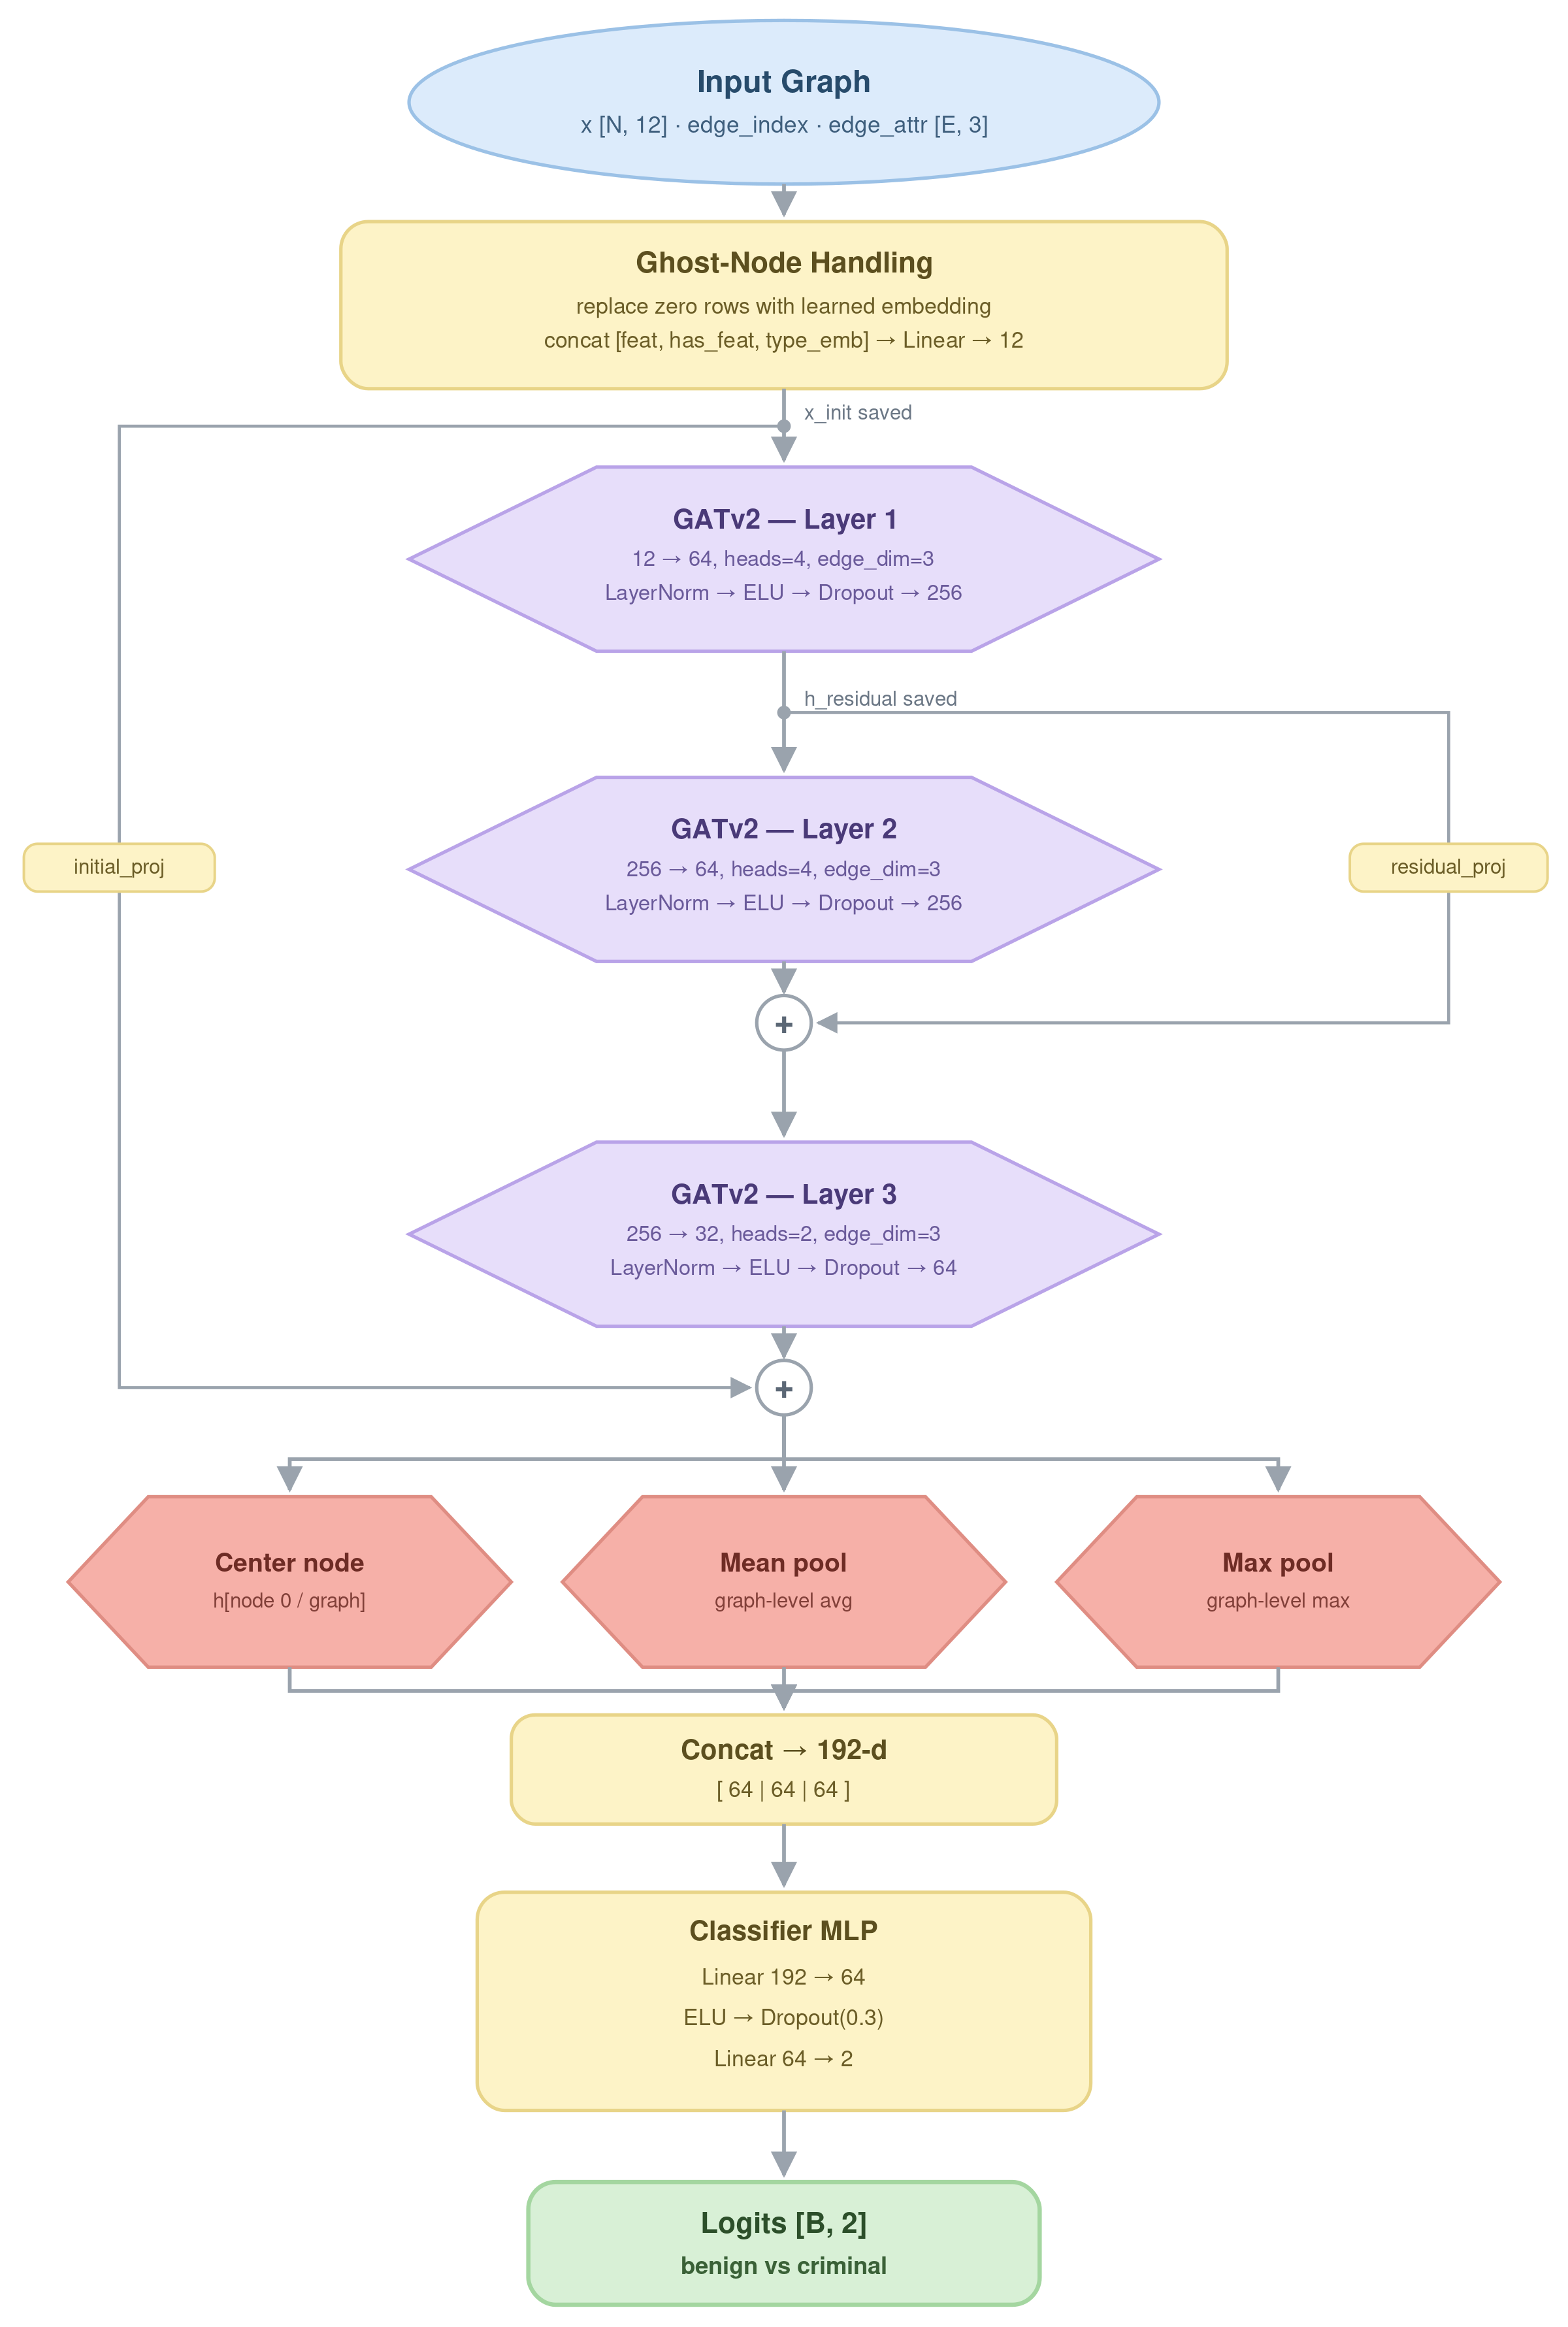

THE MODEL — OPTIMALBITCOINGNN
3 × GATv2 layers
Multi-head attention: 4 → 4 → 2 heads, edge features included
Residual connections
Stable training for deeper graph propagation
3-way pooling
Center node + mean + max → 192-d wallet embedding
Calibrated output
Temperature scaling → probabilities you can trust
Why attention? Not all neighbors matter equally — the model learns which counterparties are suspicious context.

Slide 8
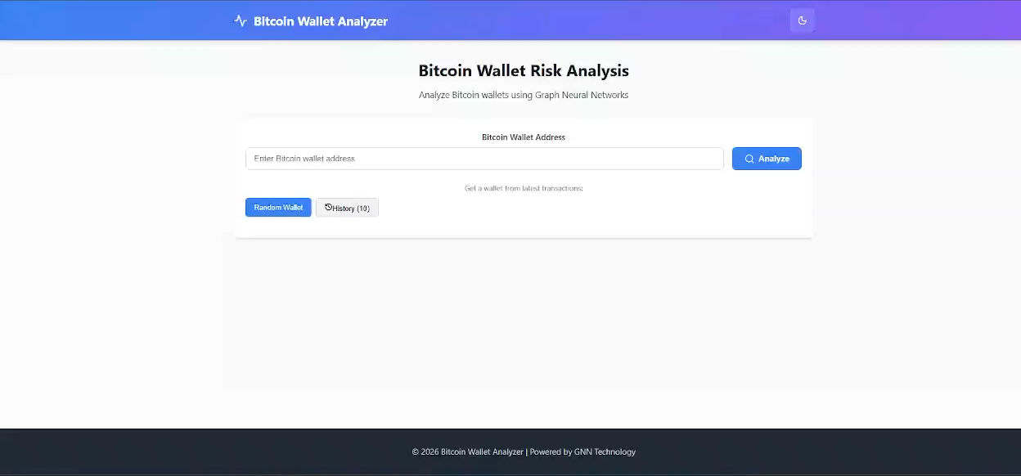
DEMO

Slide 9
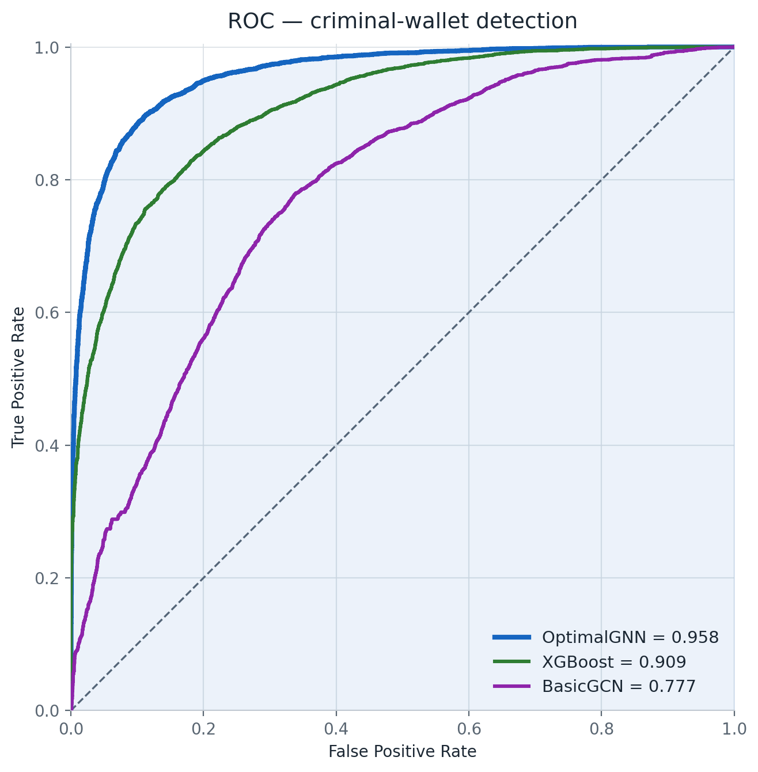
RESULTS — EVALUATION
11,880 held-out wallets · 4,740 criminal · never seen in training
89.4%
0.959
88.3%
0.87
Accuracy
ROC-AUC
Recall (criminal)
F1 (criminal)
CONFUSION MATRIX
 | Pred. Benign | Pred. Criminal
Actual Benign | 6,432 | 708
Actual Criminal | 550 | 4,190
Only 550 of 4,740 criminal wallets missed. Recall is what matters when screening for crime.

Slide 10
DOES GRAPH STRUCTURE MATTER?
Same 12 features, same test set — three models
+21 pts recall over XGBoost — the strongest feature-only baseline
Why? The criminals XGBoost misses are the ones hiding behind normal-looking features. Their neighborhood exposes them.

Slide 11


LIMITATIONS & FUTURE WORK
HONEST LIMITATIONS
FUTURE WORK
Labels are imperfect and dated — criminal behavior drifts over time
Temporal GNNs — model how wallet behavior evolves
Ego-graphs limited to 1 hop — long laundering chains can escape
Deeper / larger graphs with sampling for full-chain coverage
No formal user study of the web tool yet
Exchange integration: real-time screening at deposit time

Slide 12
SUMMARY
1
2
3
Graph structure is essential
Attention wins
It's a real tool
Connections catch criminals that features alone miss
GATv2: 89.4% accuracy, +21 pts recall over a strong XGBoost baseline
Live address → calibrated risk score, not just a notebook
The blockchain is public — we built the lens that makes crime on it visible.
Thank you · Questions?

